Slide 1








CALL LABS
E M UD ES N :
TEAM MEMBERS
Lovish Bansal(2210992584)
Lovisha Bansal (2210990546)
Lavish Jain(2210990541)AV
Course Coordinator :
Dr. Harveen Kaur
CHITKARA
UNIVERSITY

Slide 2







AIM
To study about python and python functionalities and to learn about list functions.
PROBLEM STATEMENT
In today's era of modern technology due to large number of contacts people face difficulty in remembering contacts so call labs is nothing but a contact book to store your Contacts.
CHITKARA
UNIVERSITY

Slide 3




PROCEDURE
As we discussed before , we made a project on Jupiter notebook as CALL LABS.
In this project, We’re gonna discuss functionality of list, its mobility and its characteristics.
We’re gonna add, delete, edit our list, search elements in list using manual search.
CHITKARA
UNIVERSITY

Slide 4






STEPS :
The procedure of building this project in python , we will need to execute as follows :
Step 1 :
Firstly we’re defining a list. Then, we’re going to make various operations stated down below.
Edit
Search
Delete
Add
Step 2 :
We will define and call functions for each functionality. For inputting the DATA, We will check character wise not string wise.
Step 3 :
Then, we will take input for each bottom S for Search, E for Edit, D for Delete, etc.
Step 4 :
Then, we will add C for Closing our loop i.e. our contact book
CHITKARA
UNIVERSITY

Slide 5
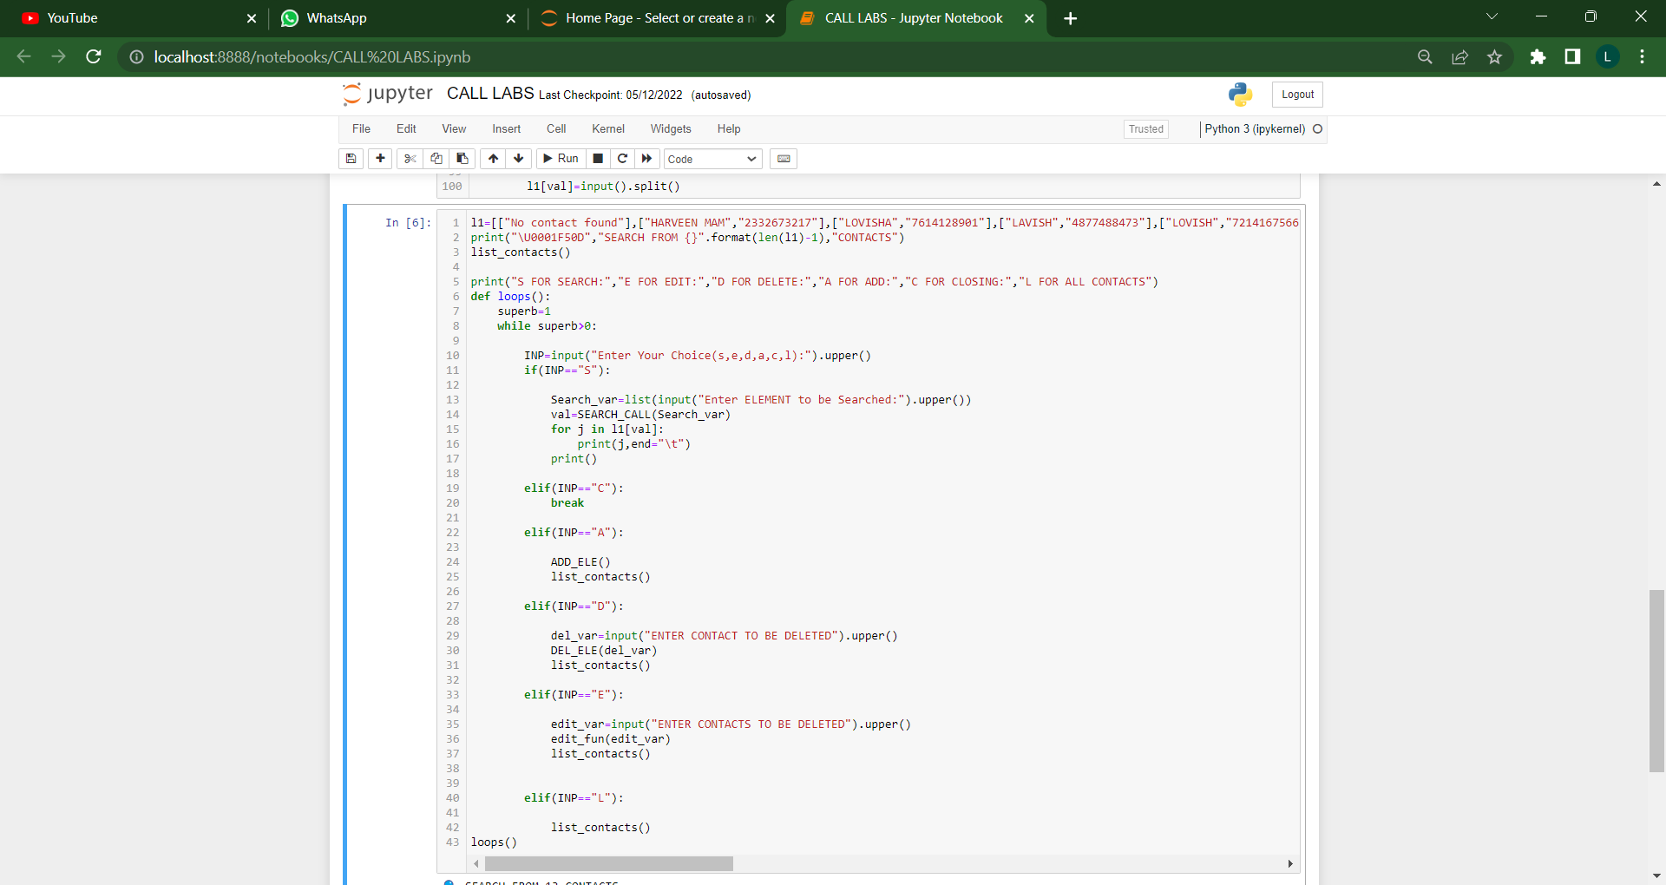
CHITKARA
UNIVERSITY

Slide 6




EXPLANATION
As in the previous slide code snippet :
In the starting of code we will print the operations we are going to perform, example- adding, deleting, editing, searching.
After that we ask for input like for every operation first for choice of operation…
Using if-else condition we check their choice of operations which User will tell us. Then Operation will be performed with taking inputs etc..
If choice is wrong, Program will not show any operation instead it will just move on.
Whenever a condition gets satisfy based on the user input, we will perform some defined function which we have defined before.
CHITKARA
UNIVERSITY

Slide 7
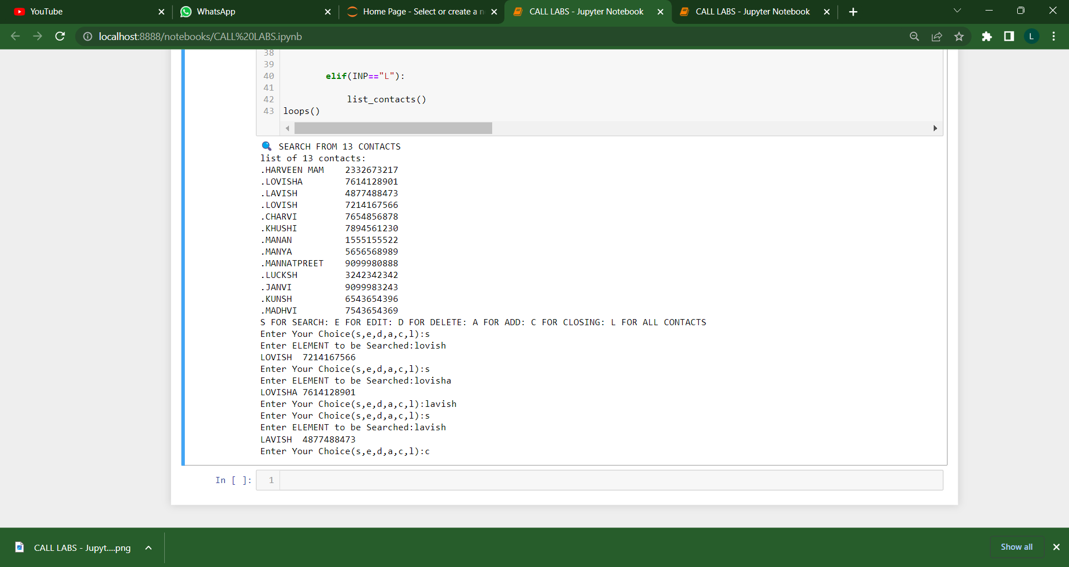
CHITKARA
UNIVERSITY

Slide 8



EXPLANATION
Manually, For every operation, first of all it will search that element then suppose,
SEARCH :- if element is found in the list, then it will display all the contact details else it will display the message “ Contact Not Found ”.
ADD :- if element is found in list, Then it displays the message “ Item is already present in the list ”. Else it will add the given input to your LIST.
DELETE :- if element is found in your list then It will confirm whether you surely want to delete this contact (Input YES for confirmation and NO for cancelling). Else it will display this message “ Contact Not Found ”.
CHITKARA
UNIVERSITY

Slide 9
EXPLANATION
Manually, For every operation, first of all it will search that element then suppose,
EDIT :- if element is found, then it will ask u to write the contact again, and the ask for confirmation (Input YES for edit and NO to cancel), Else It will display message “ Contact Not Found ”.
LIST :- if list function i.e. “ L ” is given as input, CALL LABS will give list of all contacts and will show counted numbers.
CLOSE :- if close function i.e. “ E ” is given as input, CALL LABS will quit and program will be exited.
CHITKARA
UNIVERSITY

Slide 10



RESULT :
In previous slides, We explained you about various operations of CALL LABS, How it works.
With Future, Knowledge may let us allow to add more functions to our CALL LABS.
***
CHITKARA
UNIVERSITY

Slide 11







THANK YOU
for your attention
CHITKARA
UNIVERSITY

